Slide 1
Alignment -> the act of aligning or state of being aligned; especially :the proper positioning of parts or state of each other.
(https://www.merriam-webster.com/dictionary/alignment)
Skills Mismatch is defined as the gap between an individual’s job skills and the demands of the job market;. (http://www.skillsmismatch.thinkyoung.eu/)
Job Satisfaction is the feeling of pleasure and achievement that you experience in your job when you know that your work is worth doing, or the degree to which your work gives you this feeling: (http://dictionary.cambridge.org/dictionary)
Many people are more interested in job satisfaction than in earning large amounts of money.

Slide 2
Background and Importance of the Study

Slide 3
Background and Importance of the Study
Saint Francis of Assisi College began its operation in schoolyear 1981-1982, with its first campus located at Talon Admiral Las Piñas. As of this day they have 9 campuses which are located in the following areas: two in Las Piñas, Taguig, Alabang, Bacoor, Los Baños, Biñan, Dasmariñas and Sta Rosa. Out of that 9 campuses, two of the campuses (Main Campus Las Piñas and Bacoor Campus) is offering Tertiary Level which began in schoolyear 1999-2000, with its first batch of graduates thus:

Slide 4
SFAC Main Campus (Las Piñas)
4-year degree programs = April 2003:
Bachelor of Science in Business Administration
Bachelor of Science in Computer Science
Bachelor of Science in HRM
Bachelor of Science in Elementary Education
Bachelor of Science in Secondary Education
Bachelor of Arts in Psychology
Bachelor of Science in Nursing
5-year degree programs = April 2004:
Bachelor of Science in ECE
Bachelor of Science in Electrical Engineering
Bachelor of Science in Computer Engineering
SFAC (Bacoor Campus)
2-year non-degree programs = April 2003:
Associate in Computer Technology
Associate in Hotel Restaurant Management
4-year degree programs = April 2003:
Bachelor of Science in Business Administration
Bachelor of Science in Computer Science
Bachelor of Science in Hotel Restaurant Management
Bachelor of Science in Elementary Education
Bachelor of Science in Secondary Education

Slide 5
Since the first batch of graduates until now there has not been a formal study on the whereabouts of this graduates, only those people who is excelling on their profession are track but in an informal manner (thru social networking sites, email, written survey, but not religiously compiled), meaning they don’t have really this tracking system impose on their graduates that is why this idea was formulated on the researcher side, to create a tracking system.
(General pained point: Where are all my Alumni?)

Slide 6
Literature Review

Slide 7
Literature Review
- Employment
School Related Factors
Curriculum
Curriculum Content
- Faculty
Student Services
Administration
Community Extension Linkages

Slide 8
Literature Review
According to Jobstreet.com 7 out of 10 Filipino employees are happy with their jobs. Fresh graduates are happiest at 79 percent, followed by junior executives (70 percent), supervisors (67 percent), and directors up (68 percent), while managers scored the lowest percentage of happy employees at 66 percent.
Levels of satisfaction also see a marked decrease as employees stay longer in their jobs. Those who have stayed in their companies for less than a year are most satisfied at 75 percent, followed by those who have stayed from one to three years at 72 percent, while only 65 percent of those with longer period of tenure at three to five years are happy and only 62 percent of those who have stayed with the company for more than five years consider themselves happy.

Slide 9
Cont…Literature Review
Employment
Unemployment rate increases 5.7% in January 2016 to 6.6% in January 2017 according to Labor Force Survey. Because of the increase in unemployment rate, the number of employed Filipinos also declined from 94.3 percent last year to 93.4 percent in January of 2017. This translates to 39.3 million employed individuals, a number which is lower by 1.34 million or 3.3 percent compared to the same month last year. NEDA however clarified that the rate this year was still lower than the average of 7.4 percent recorded from 2006-2015.
(http://www.philstar.com/business/2017/03/14/1681058/unemployment-rate-increases-january-2017)

Slide 10
Cont…Literature Review
School Related Factors
A study entitled “A Case Study Of School - Related Factors Affecting Nigerian Secondary School Pupils’ Academic Performance” by Dr. Olaniyi Bojuwoye mentioned that inadequate resource materials for teaching seem to be the characteristic that has the greatest effect on pupil academic performance.
Thus it has been argued that without adequate resource materials for teaching in a large over-populated classroom and with the teacher having overload of teaching schedule such a situation can dampen the spirit of an articulated teacher and make her or him very ineffective.

Slide 11
Cont…Literature Review
Curriculum
Citing the CHED Memorandum Order No.25 Series of 2015, on Policies and Standards for Bachelor of Science in Computer Science, Information Technology, Information System , the program goals for this graduates are to become:
Globally competent, innovative and socially and ethically responsible computing professionals engaged in life-long endeavors.
They must be capable of contributing to the country’s national development goals.

Slide 12
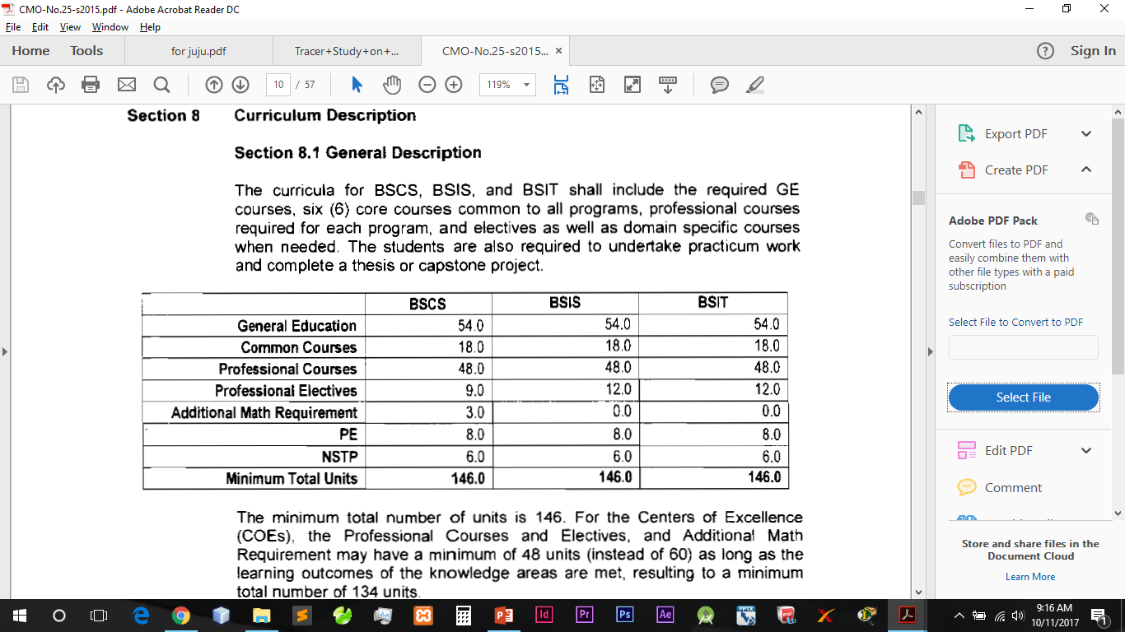
Cont…Literature Review
Curriculum Content

Slide 13
Cont…Literature Review
Faculty
The CHED Memorandum Order No.25 Series of 2015, “The quality of higher education in any institution depends on the quality of its faculty. For this reason, the government prescribes that teachers at the tertiary level must have a Master’s Degree in the field in which they teach.

Slide 14
Cont…Literature Review
Student Services
In a Journal review entitled “The relevance of a library in the 21st century: Students perception according to Omeluzor et. al resource sharing and networking is a viable method of communicating information resources among libraries in this era. Okeagu and Okeagu (2008) argued that no library, no matter how it is funded can acquire all the materials needed by her users; therefore, the way to achieve cooperation among libraries is through the establishment of consortiums – a syndication arrangement which enables libraries to work together more effectively and efficiently. SFAC is now having the idea of having an Inter-Library System that will connect the different campuses.

Slide 15
Cont…Literature Review
Administration
Some role of an administrator is to facilitate teaching and learning by acting as educational leader, instructional leader, decision maker, manager, an advocate and a colleague that works with teachers to provide an educational culture and conducive to student learning and professional growth. Although there is no direct study of relationship between the Administrator and students achievement but administration does strongly influence school environmental conditions affecting such growth (school facility). (https://www.teachers.ab.ca/For%20Members/Programs%20and%20Services/Resources%20For/SchoolBased%20Administrators/Pages/Role%20of%20the%20Administrator.aspx )

Slide 16
Cont…Literature Review
Community Extension and Linkages
The Community is described as a group of people living and or working in defined geographical and social boundaries; has Leadership and decision making processes; and consists of diverse social, cultural and economic groups. They are the direct or indirect beneficiaries of the services.
Kilpatrick on his study “Maturing school–community partnerships: developing learning communities in rural Australia” emphasized that Communities and schools that share the belief that education is the responsibility of the whole community and work together, drawing on skills and knowledge of the community as a whole, experience benefits that extend far beyond producing a well-educated group of young people. The level of maturity of the school–community partnership dictates how schools and communities go about developing and sustaining new linkages, or joint projects. It must be recognized that building of school–community partnerships occurs over time, and leadership processes must acknowledge and build on shared school-community vision. (from: Academic Research International)

Slide 17
Pained Points

Slide 18
The Administration Problem
Continual improvement of quality education.
Increase the number of enrollees.

Slide 19
The Problem for the SFAC External Affairs Office
Track down SFAC graduates and find their current employment status.
Batch Statistical Report (yearly report)
How many take the licensure exam (who pass/failed)
How many did not take the licensure exam
How many Alumni that their course is aligned to the job/not aligned to the job
How long did a graduate landed a job:
1-6 months
7-12 months
1-2 years

Slide 20
Cont.. (SFAC External Affairs Office)
2. What competent skill they developed during their college days?
3. Centralization Alumni Information
Out of 9, SFAC have 2 campuses that have college offerings (Main campus which in Las Piñas and the other one is in Bacoor campus) and for that SFAC want to centralize the information of SFAC graduates.

Slide 21
Different College Coordinator Problem:
The Relevance of the Curriculum Offerings (Guided by the CMO)
How responsive and relevant the current curricular offering of SFAC to the demands of the labor industry.

Slide 22
The Propose Solution
SFAC-WBGTSAT

Slide 23
The Propose Solution: (Tracking of Alumni)
To create a data driven business analytics solution to track all the graduates of SFAC Main and Bacoor Campus. Having the data of all alumni will help the external affairs office to create a statistical report that will be use to update the School Administrator. The School Administrator can now then use this data, as one of the factor in increasing the number of enrollees in SFAC. The different College Coordinators specifically the curriculum development people (coordinators and faculty) will now have an idea as to what subjects need revisiting (guided by the CHED Memorandum Order CMO on curriculum development) and last to the faculty, to give them the idea on how to best to strategize every subject that they are handling.

Slide 24
The value/advocacy…
The value that the researcher want to incorporate here is that the responsibility of the school cares for every Alumni. That is why this propose system will be created, so that it does not track only those alumni that is successful, but also those alumni that is having hard time to find a job, or have a job, but a not align job base on their Bachelor’s Degree.

Slide 25
SFAC Graduate Tracer Study Analysis Toolkit
SFAC-WBGTSAT

Slide 26
https://www.pcmag.com/encyclopedia/term/52987/toolkit
Toolkit
A single utility program, a set of software routines or a complete integrated set of software utilities that are used to develop and maintain applications and databases.
http://www.businessdictionary.com/definition/analysis.html
Analysis
1. A systematic examination and evaluation of data or information, by breaking it into its component parts to uncover their interrelationships.
2. An examination of data and facts to uncover and understand cause-effect relationships, thus providing basis for problem solving and decision making.

